Slide 1
Albuquerque Vehicle Emissions Data Analysis
Nick Folse, Jacob Girgle, & Trisha Terhar
Notes:
TT

Slide 2
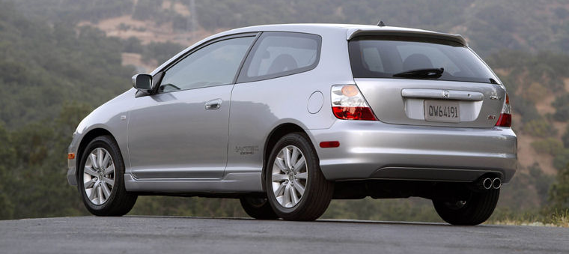
Research Questions
Is there a predictable linear trend in emissions test failure rate vs. vehicle age?
Is there a statistically significant difference in the performance of certain models, compared to the population average, on a vehicle-age basis?
Notes:
X Brief summary of the research question

Slide 3




Relevance
Aftermarket Car Parts
Used Car Purchasers
Police Departments
Notes:
How/who can this data help?
Scenario 1- You’re in charge of fleet purchasing for the APD. You want to choose a vehicle model with strong track record that won’t incur significant maintenance costs for the department down the road.

Slide 4
Data Set Overview
Albuquerque Vehicle Emissions Database
Environmental Health Department / Vehicle Pollution Management
A record of every emissions test in the city
Abundance of data (~257,000 records per year):
2013: 257,673; 2014: 258,985; 2015: 257,790; 2016: 259,865; 2017: 251,397
We used a reduced dataset:
based on 2014-2017 data
50 or more records (make/model/year)
represents 822,763 individual reports
only consider pass/fail status
References:
https://www.cabq.gov/abq-data
http://data.cabq.gov/airquality/vehicleemissions/prioryears/VehicleEmissionsccyy_CABQ-en-us.csv (2013-2017)
Notes:
Reduced data set leveraged (weighted impetus)
2014-2017 data (not vehicles)
“Brief summary of the descriptive statistics for the main variable of interest”

Slide 5
Methodology
A) Piecewise Linear Regression (weighted¹)
independent variable: vehicle age (years)
dependent variable: failure rate
weighted based on number of vehicles in each category
B) Large-sample hypothesis test of proportions
“Does a vehicle of specific make/model/age perform better or worse than typical vehicle of the same age?”
Assume population is total available dataset
H​0​​: p​[vehicle,age]​​ = p​[age]​​
H​a​​: p​[vehicle,age] ​​> p​[age]​​ or p​[vehicle,age] ​​< p​[age]​​
¹ weighted least squares: https://newtonexcelbach.com/2017/02/05/weighted-least-squares-regression-using-excel-vba-alglib-and-python/
Notes:
TT
Multiple models (equations)

Slide 6
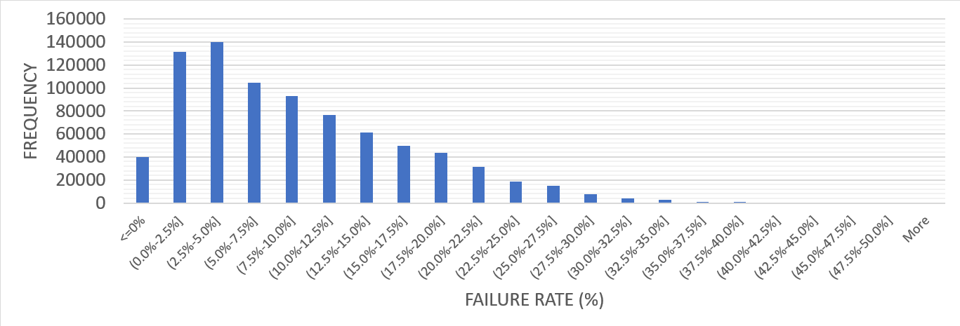
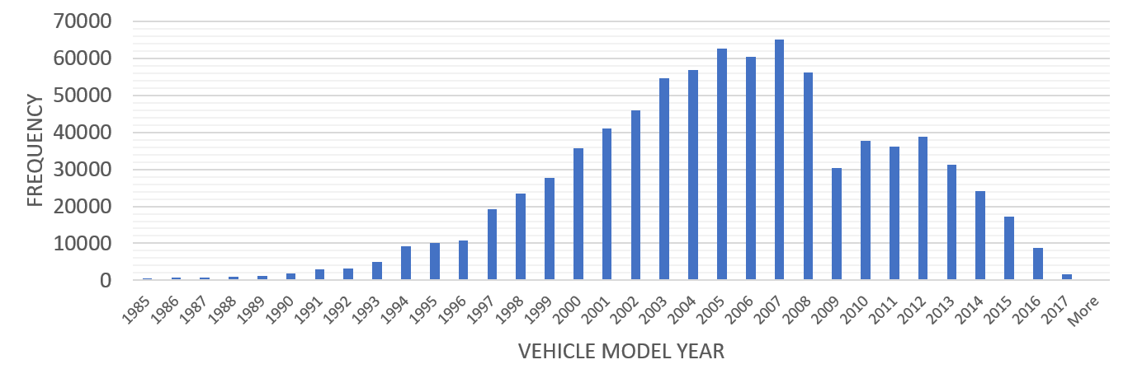
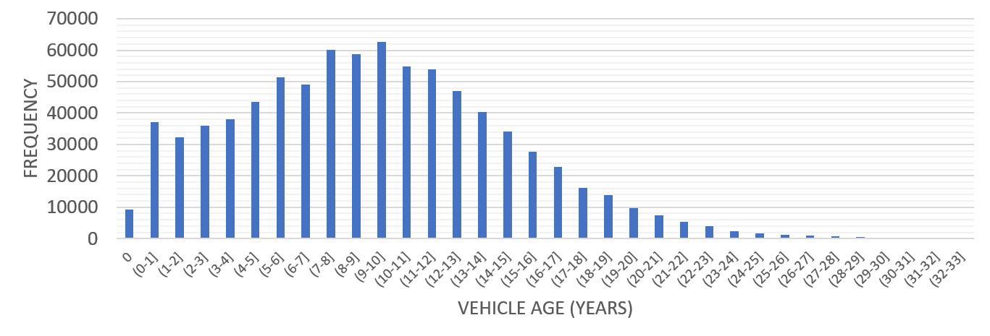
Descriptive Statistics Summary
Dependent
failure rate: median = 7.8%, mean = 9.6%
model year: median = 2005, mean = 2005
Independent
vehicle age: median = 10, mean = 9.996
Notes:
JG
Includes all years and all model makes. Failure rate of entire data set, right skewed. Expect that if we model it based on time the distributions based on year will be more normal.
Blimp shows up in all data: do not know reason
calculated : test date year - model year of the car. Variation dependent on date of test
Linear regression: independent vehicle age and dependent failure rate

Slide 7
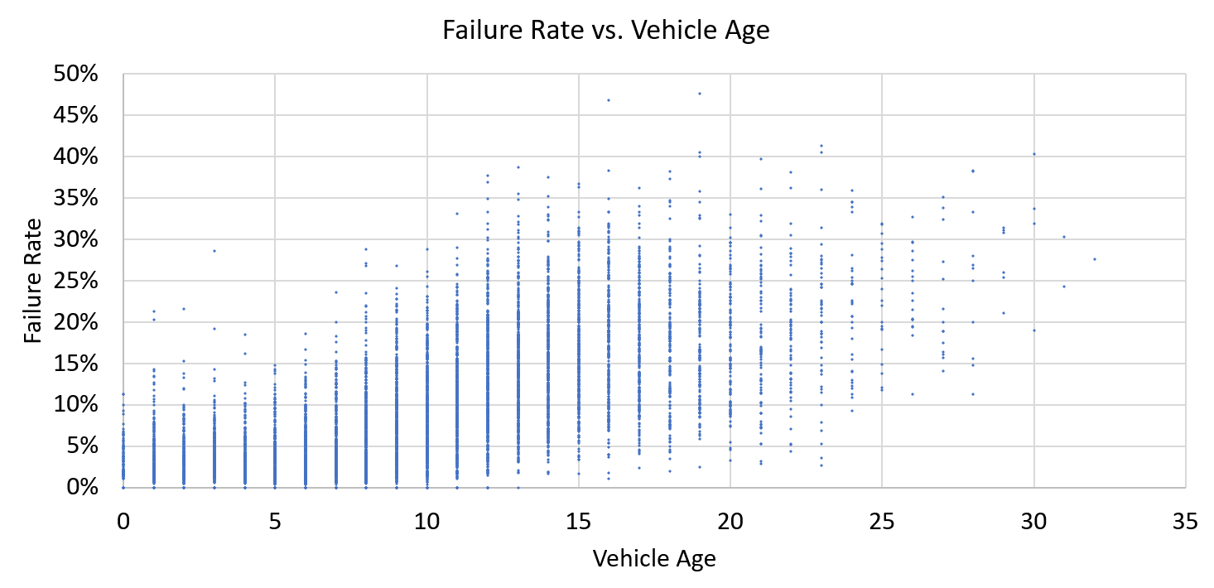
Scatter Plot

Slide 8
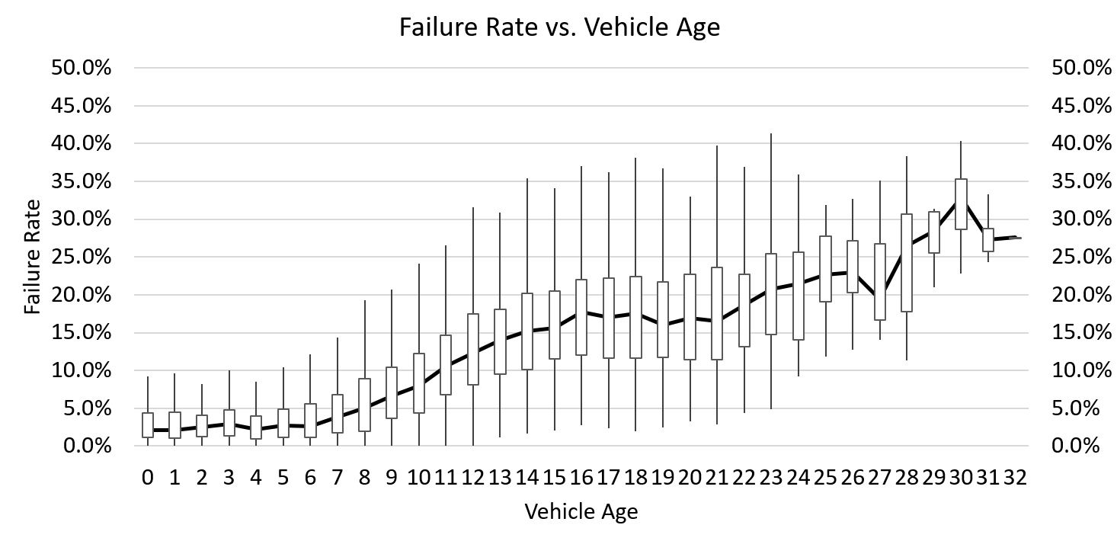
Box-and-Whisker
Notes:
Good number of outliers but the interquartile range stayed consistent until you move into the older vehicles. First sight when you can begin to see a trend in the data.

Slide 9
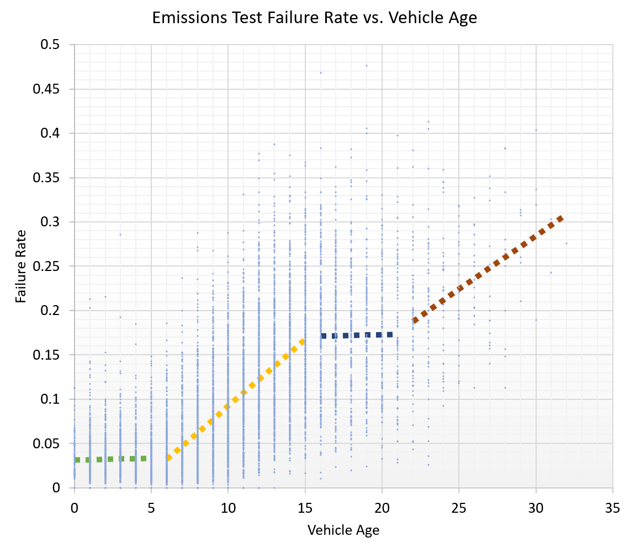
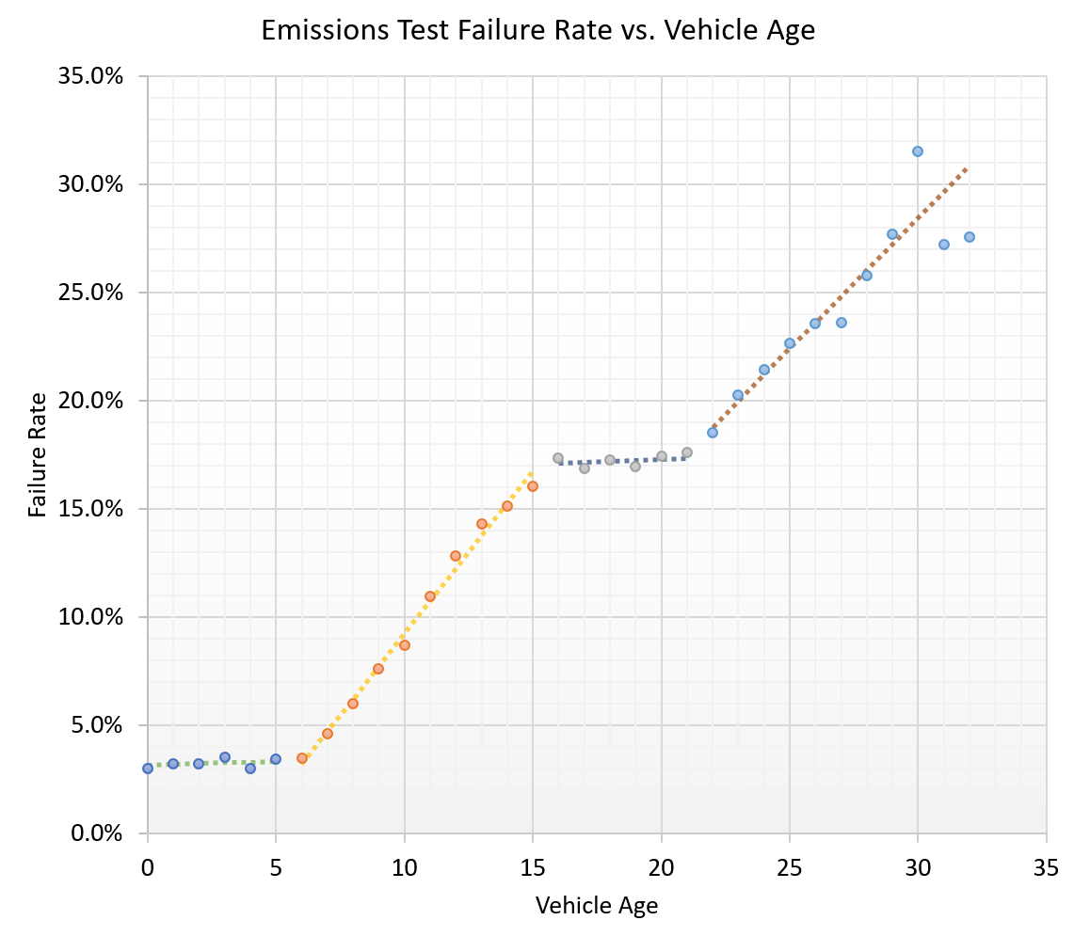
Failure Rate vs. Vehicle Age (Linear Regression)
Notes:
NF

Slide 10
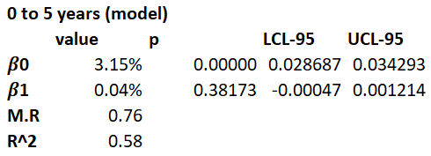
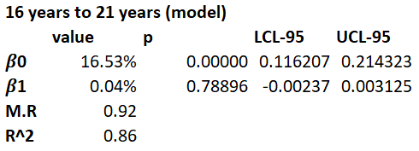
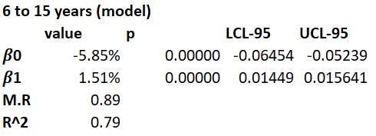
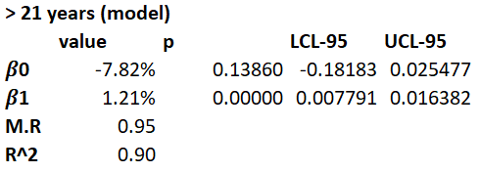
Linear Regression

Slide 11
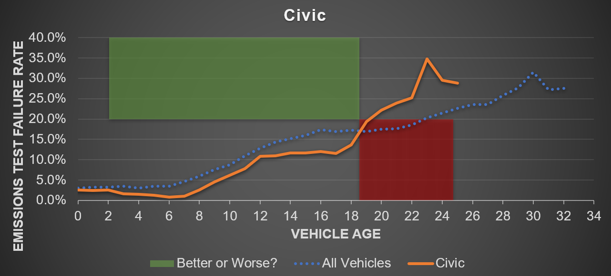
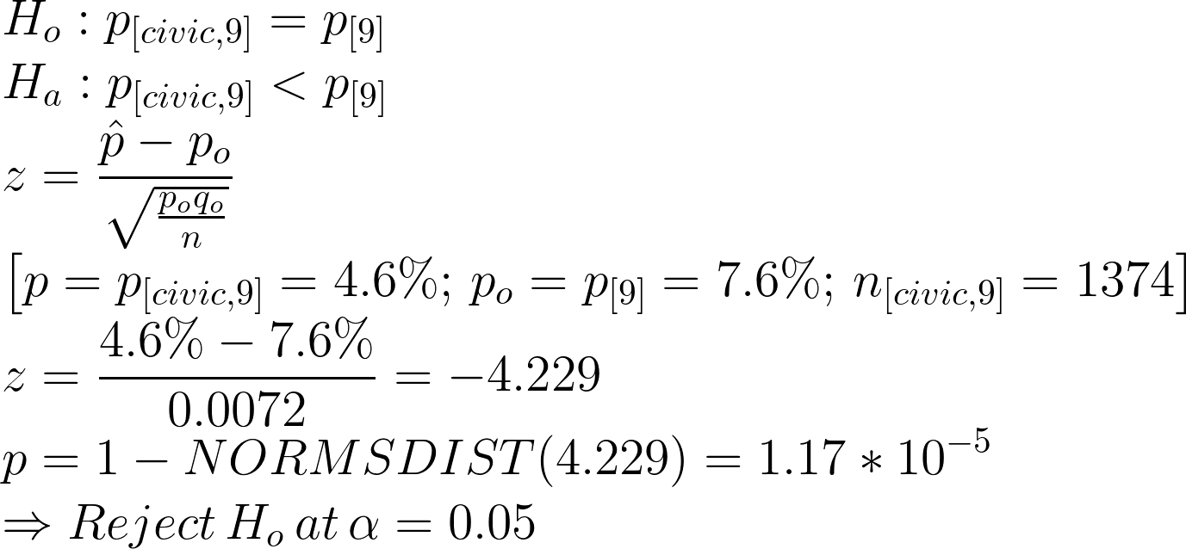
Hypothesis Testing
“Does a vehicle of specific make/model/age perform better or worse than typical vehicle of the same age?”
H​0​​: p​[vehicle,age]​​ = p​[age]​​, H​a​​: p​[vehicle,age] ​​< p​[age]​​ or p​[vehicle,age] ​​> p​[age]
Notes:
https://www.codecogs.com/latex/eqneditor.php
H_{o}: p_{[vehicle,age]} = p_{[age]} \\
H_{a}: p_{[vehicle,age]} \neq p_{[age]} \\
z = \frac{\hat{p}-p_{o}}{\sqrt{\frac{p_{o}q_{o}}{n}}}
\\
H_{o}: p_{[civic,9]} = p_{[9]} \\
H_{a}: p_{[civic,9]} < p_{[9]} \\
z = \frac{\hat{p}-p_{o}}{\sqrt{\frac{p_{o}q_{o}}{n}}}\\
\left [ p = p_{[civic,9]}=4.6\%;\,p_{o} = p_{[9]} = 7.6\%;\,n_{[civic,9]}=1374 \right ]\\
z = \frac{4.6\%-7.6\%}{0.0072}=-4.229\\
p = 1-NORMSDIST(4.229) = 1.17*10^{-5}\\
\Rightarrow Reject\,H_{o}\,at\,\alpha=0.05

Slide 12
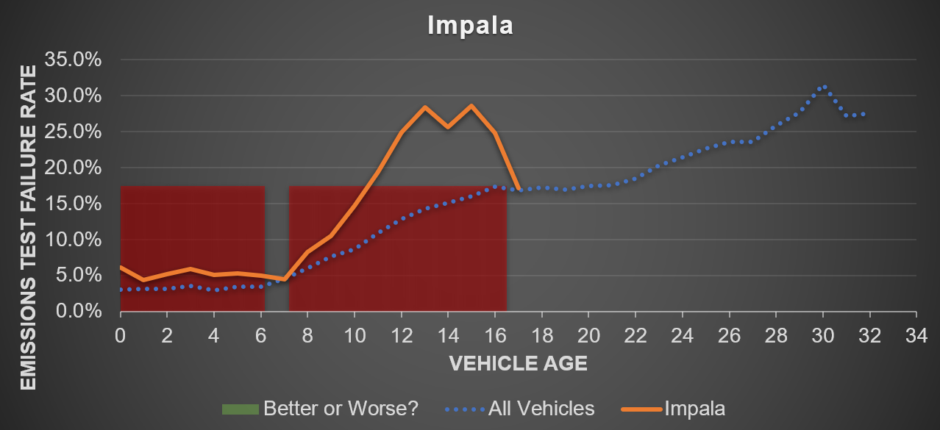
Managerial Insights
Notes:
TT
The data raises some red flags on the Impala, a popular police vehicle option
https://www.autotrader.com/car-news/most-popular-police-car-258655
“Results and managerial insights” “Discuss the potential benefit and future extensions”

Slide 13
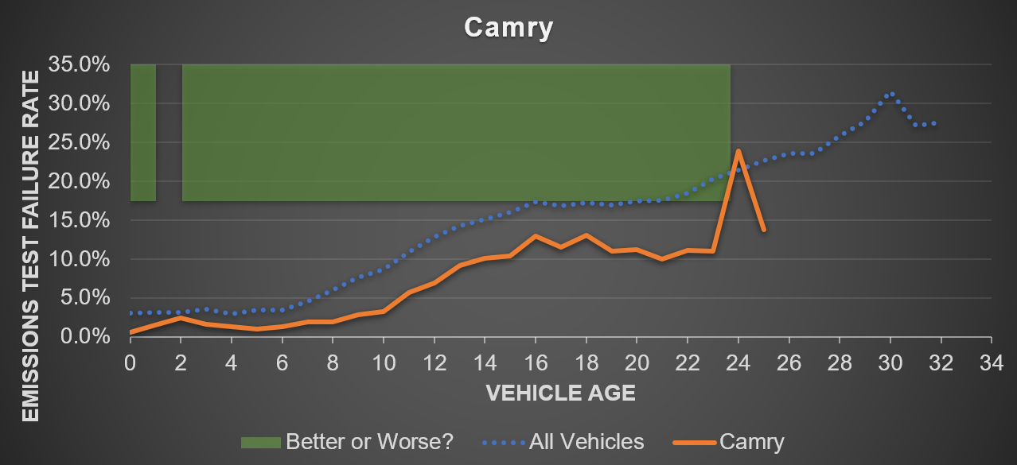
Managerial Insights
Notes:
TT

Slide 14
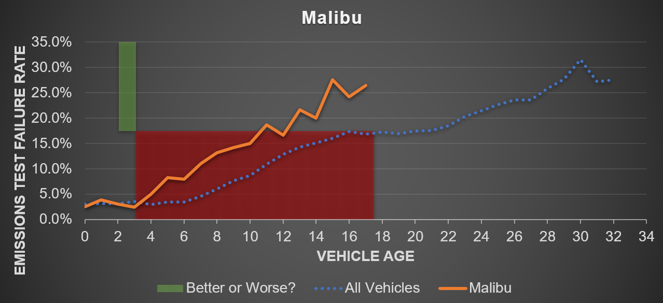
Managerial Insights
Notes:
Specific to ABQ locations

Slide 15
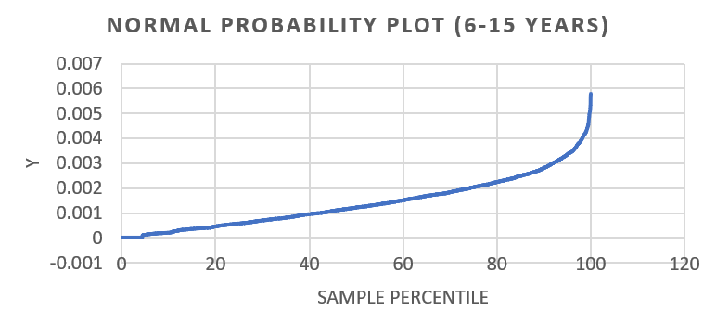
Shortcomings
linear model lumps all vehicles together, even though each vehicle model has different characteristics → non-linear normal probability
assumes population is total available dataset
sample and population are limited to ABQ dataset
no insight into cause of emissions test failure
Notes:
JG
Example of two different cars but our linear model lumps them as the same. Comparing a ford f-150 to a honda civic
No insight due to exact cause: for example how a car is driven or aftermarket parts put on a car.
Our plots are not linear due to but up to the 80th percentile our data is linear, it is only the last 20 percent that is not linear

Slide 16
Questions?
Thank you.

Slide 17
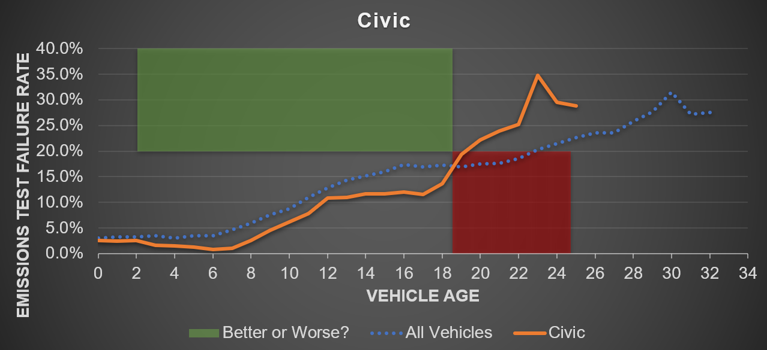
Selected Results

Slide 18
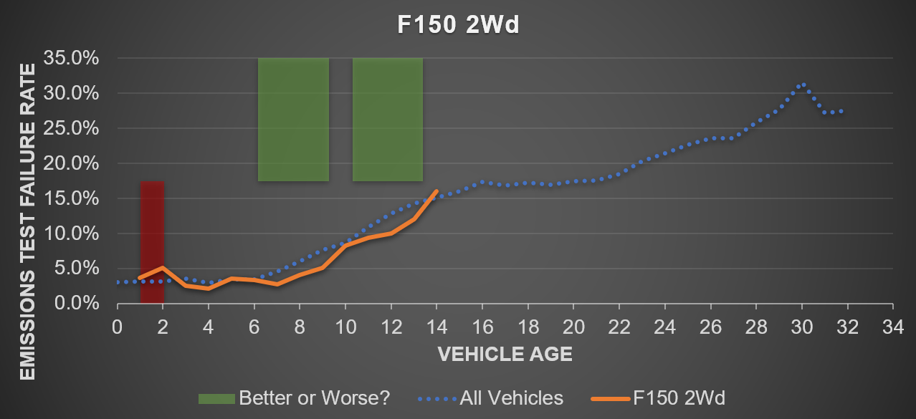
Selected Results

Slide 19
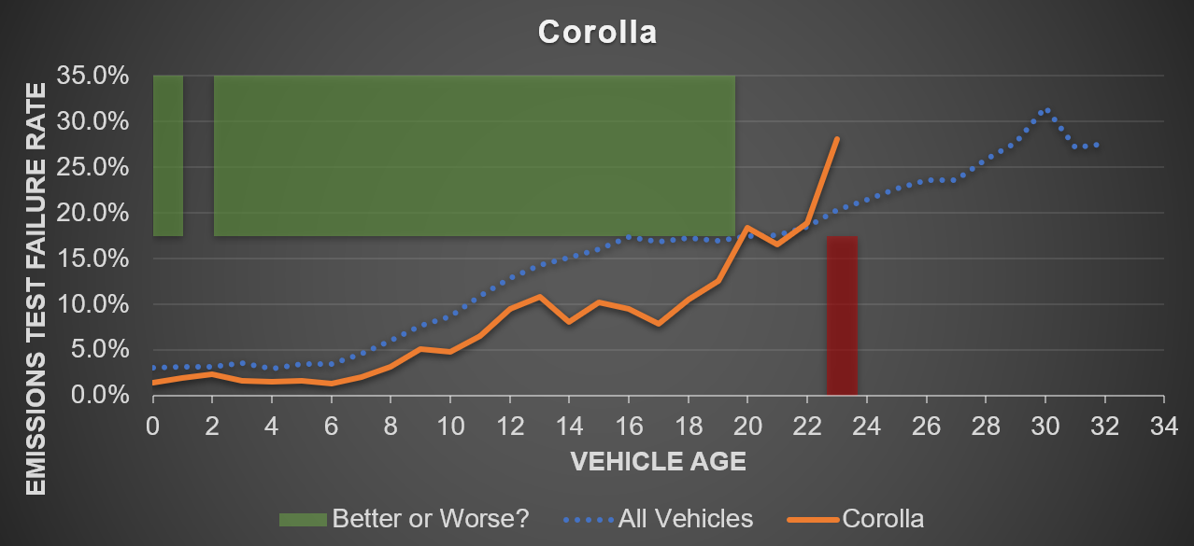
Selected Results

Slide 20
Selected Results

Slide 21
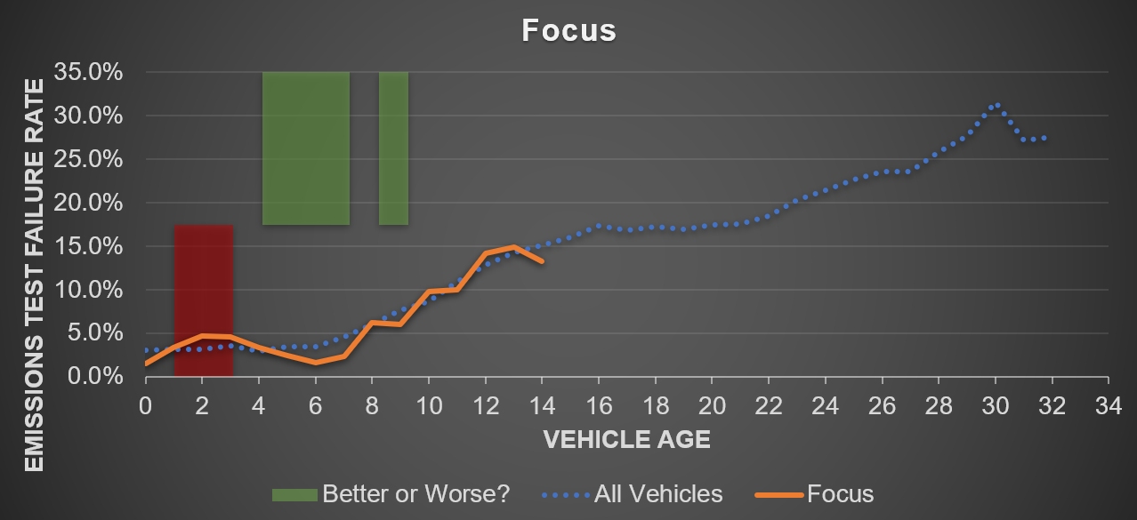
Selected Results

Slide 22
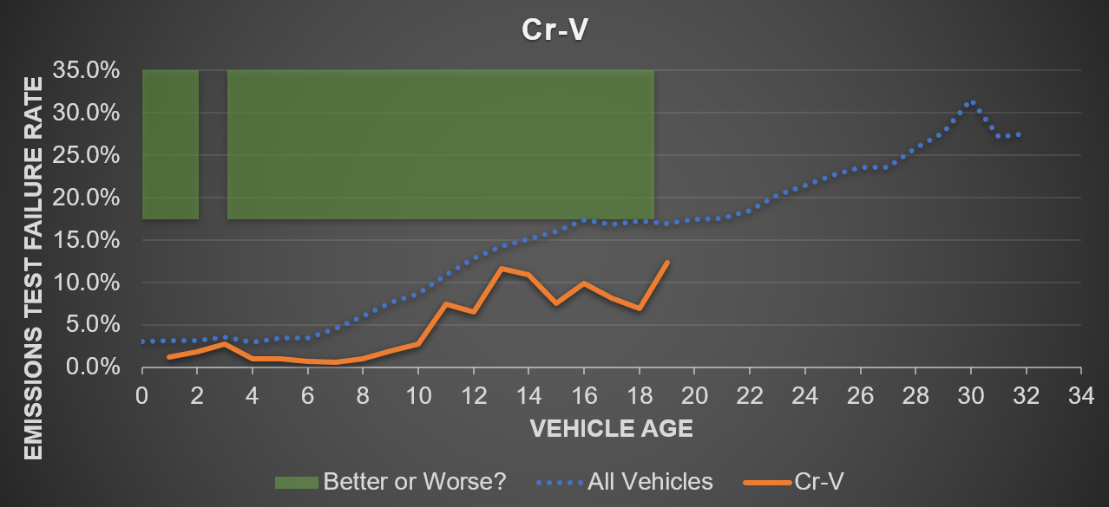
Selected Results

Slide 23
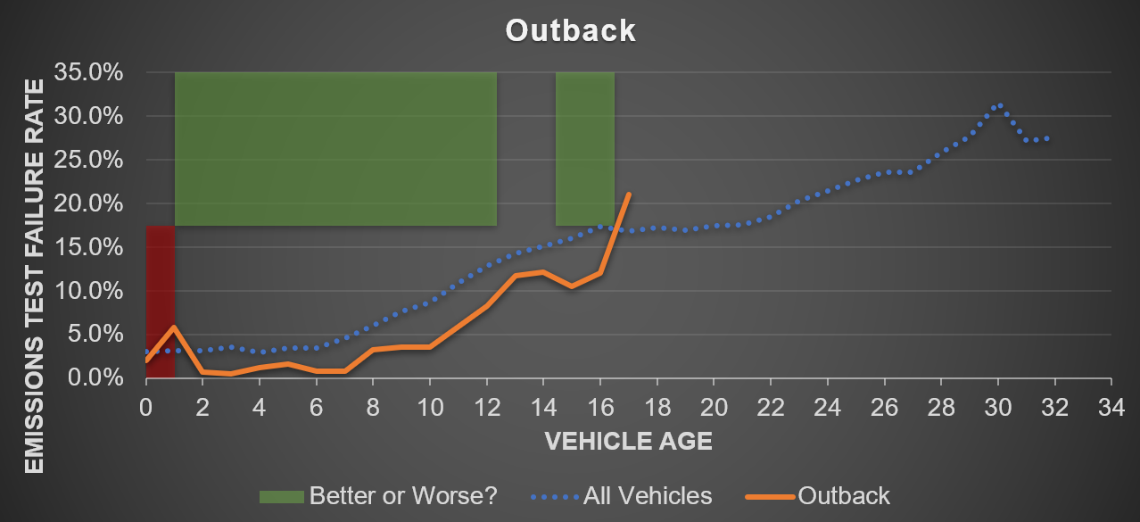
Selected Results

Slide 24
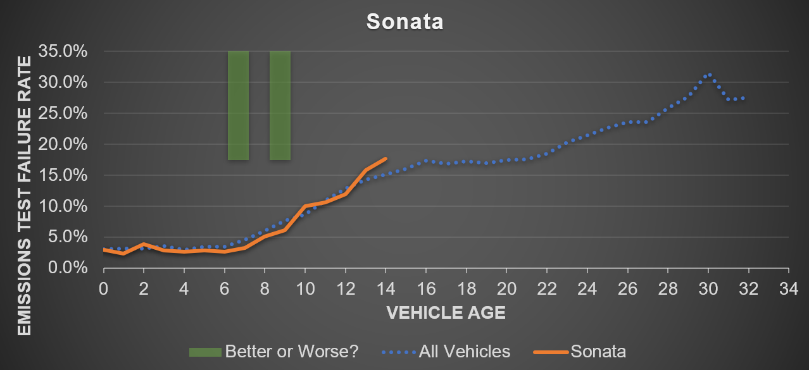
Selected Results

